Slide 1
Configuring and Deploying the Staging Environment

Slide 2
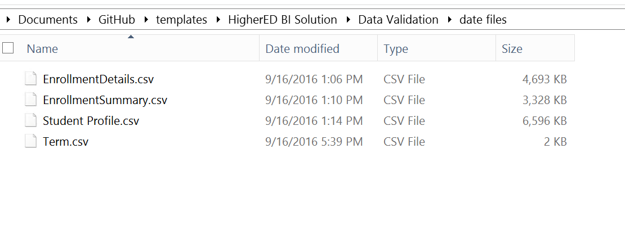
Populate the .csv Files
1. Open the Data Validation > data files folder.
2. Open and review each file.
3. Populate each file with your schools data or leave as is and go to next step

Slide 3
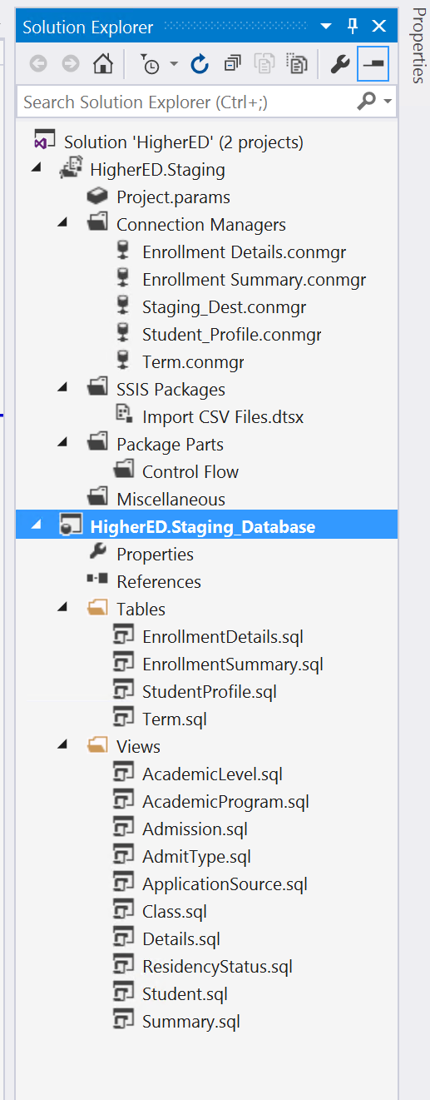
Deploy Staging Database
1. Open the HigherED.Staging Solution

Slide 4
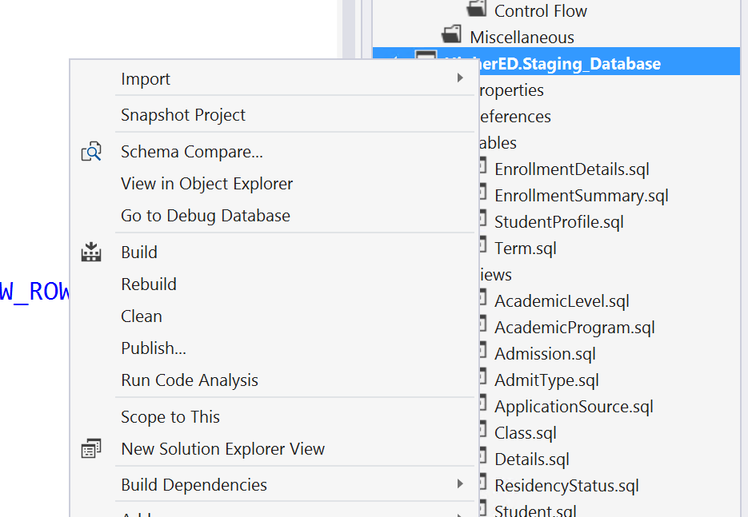
Deploy Staging Database
2. Right-click the HigherEd.Staging_Database project and select Build from the context menu.

Slide 5
Deploy Staging Database
2. Right-click the HigherEd.Staging_Database project and select Publish from the context menu.

Slide 6
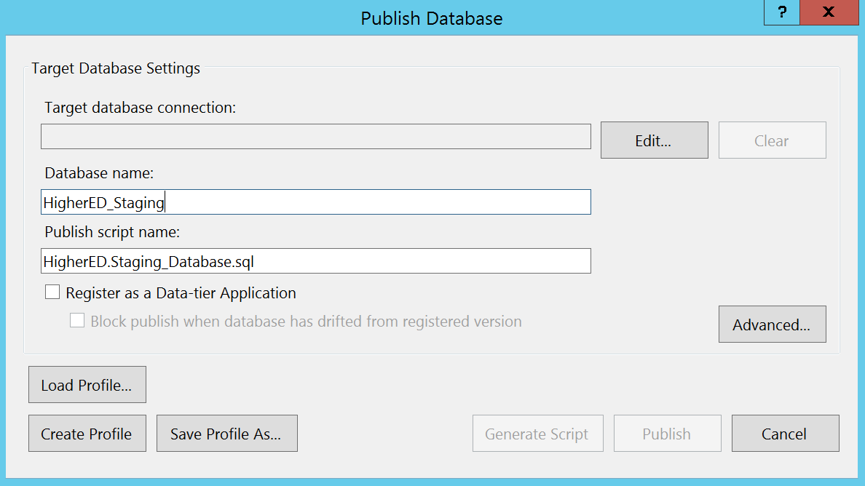
Deploy Staging Database
Enter HigherED_Staging in the textbox labeled Database name.
Click the button labeled Edit

Slide 7
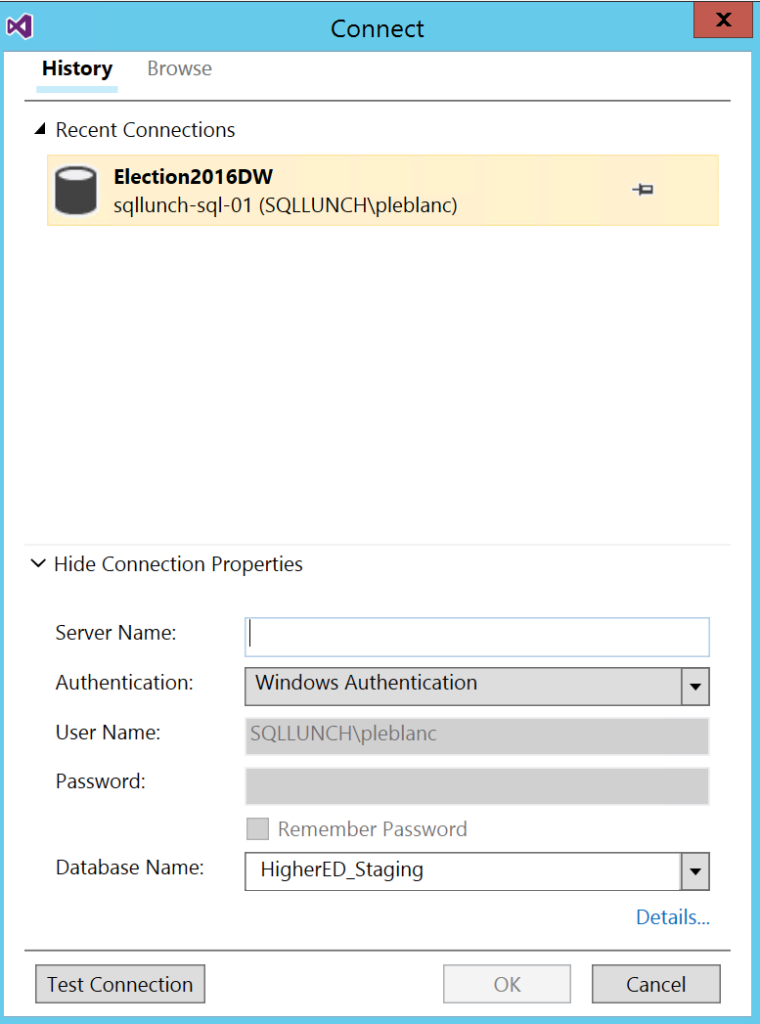
Deploy Staging Database
Click the button labeled Edit.
Click Show Connection Properties towards the bottom of the window
Enter your Server Name in the textbox labeled Server Name.
Click the button labeled OK.

Slide 8
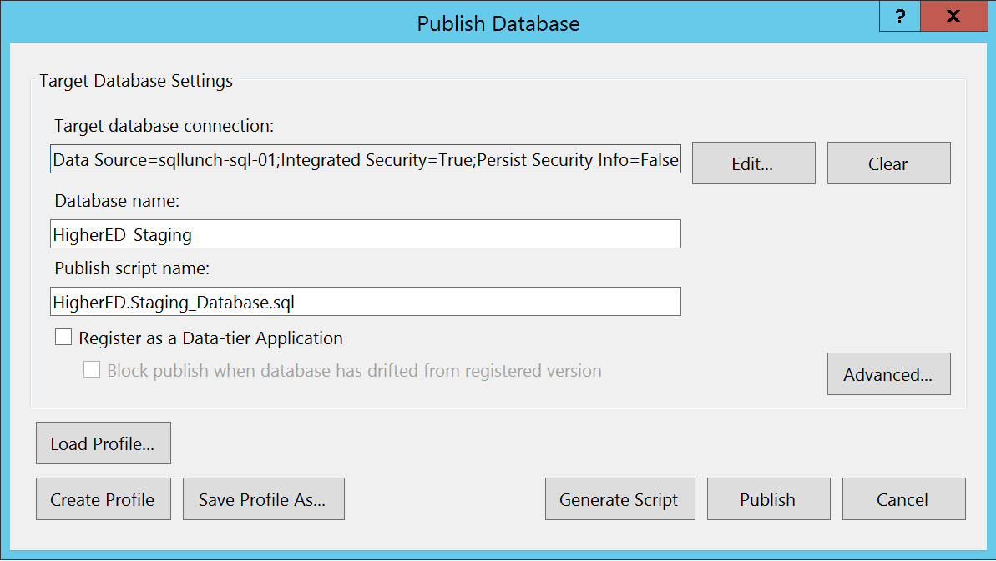
Deploy Staging Database
7. Click the button labeled OK.

Slide 9
Deploy Staging SSIS Packages
Open the HigherED.Staging Solution
Double-click Projects.params in the HigherED.Staging Project.

Slide 10
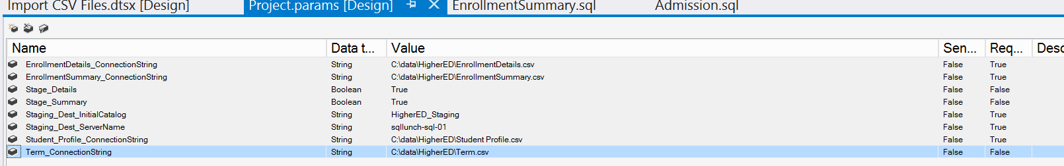
Deploy Staging SSIS Packages
Update the file location for:
EnrollmentDetails_ConnectionString
EnrollmentSummary _ConnectionString
Student_Profile _ConnectionString
Term _ConnectionString
Chabge the Staging_Dest_ServerName to your server name.

Slide 11
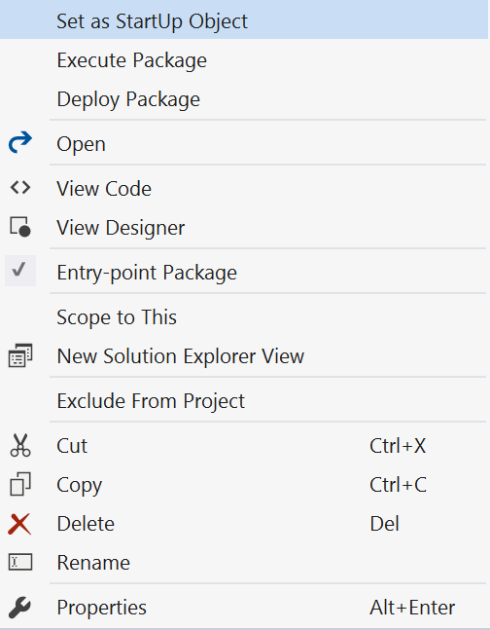
Deploy Staging SSIS Packages
Right-click the Import CSV Files.dtsx and select Execute Package from the context menu.

Slide 12
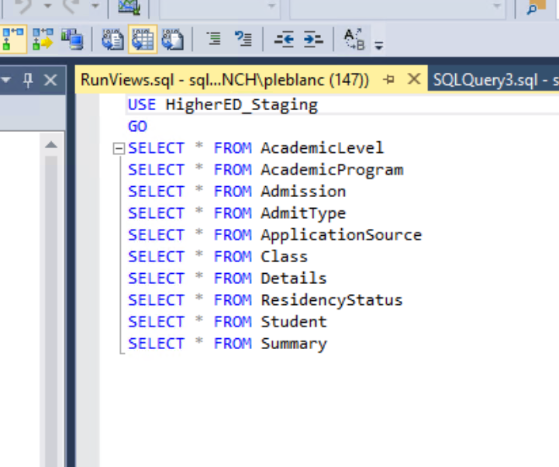
Deploy Staging SSIS Packages
Open the RunViews.sql file located in the Data Validation > scripts folder in SQL Server Management Studio.
Execute the script. If any tables are empty are errors appear you should reach out to you Microsoft Contact to help resolve.

